Slide 1


Data-Driven Insights: Analyzing Future Skill Requirements for IT Solutions and Consulting Services
Bili Choi
20th Aug 2023

Slide 2

OUTLINE
Executive Summary
Introduction
Methodology
Results
Visualization – Charts
Dashboard
Discussion
Findings & Implications
Conclusion
Appendix

Slide 3

EXECUTIVE SUMMARY
Current Technology Usage
Top 10 Languages
Top 10 Databases
Platform
Top 10 WebFrames
Future Technology Usage
Top 10 Languages
Top 10 Databases
Platform
Top 10 WebFrames
Demographic
Gender
Age
Geographical
Education level

Slide 4

INTRODUCTION
Backgound
Being a Data analyst by a global IT and business consulting services firm, this is a regular data analytic report for the company getting latest IT labour market information
Purpose
To remain competitive and keep pace with changing technology, our company regularly analyzes data to help identify future skill requirements.
What questions we need to focus
What are the top programming languages in demand?
What are the top database skills in demand?
What are the popular IDEs?

Slide 5

METHODOLOGY
Data Collection (Sources)
• Stack overflow developer 2019 survey (RDBMS)
• GitHub job postings (Web)
• Programming languages annual salary (excel)
Data Wrangling (Python)
Data Exploration (Python)
Data Cleaning (Python)
Data Visualization
Python matplotlib & turtle
IBM Cognos
Presentation

Slide 6
RESULTS

Slide 7
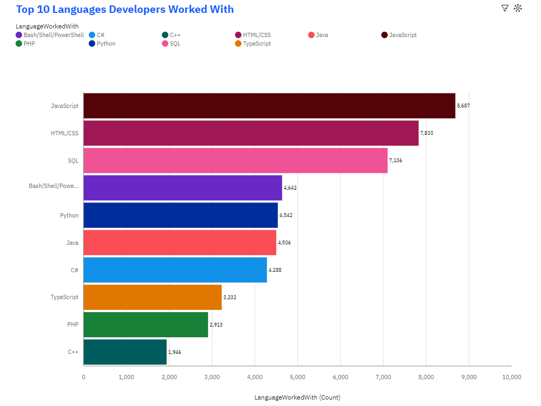
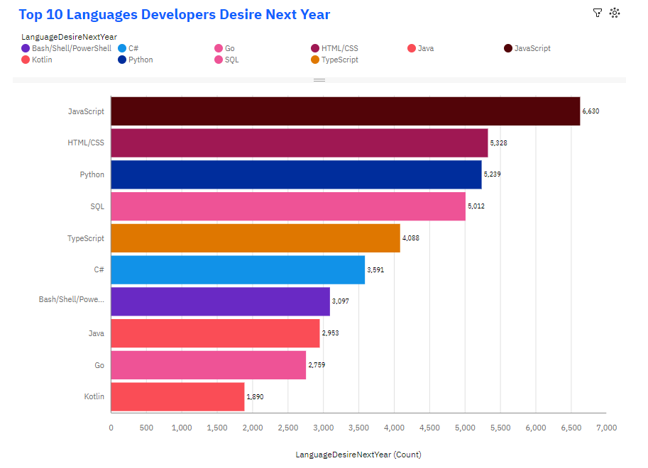
PROGRAMMING LANGUAGE TRENDS

Slide 8
PROGRAMMING LANGUAGE TRENDS - FINDINGS & IMPLICATIONS
Findings
JavaScript and HTML/CSS are the top two programming languages that have been used this year and will continue to be in high demand in the coming year
There is a high demand growth in Python (rank 5 -> 3) and TypeScript (rank 8 -> 5) from this year to next year
PHP and C++ are not desirer than Kotlin and Go for developers in coming year
Implications
Web developments is still high demand in the future and developers proficient in these languages can expect a steady stream of job opportunities
Python's versatility and ease of use (supporting SQL), along with TypeScript's static typing for JavaScript, make them attractive choices for developers and organizations.
This change may be driven by factors such as the rise of modern frameworks and technologies associated with Kotlin and Go

Slide 9
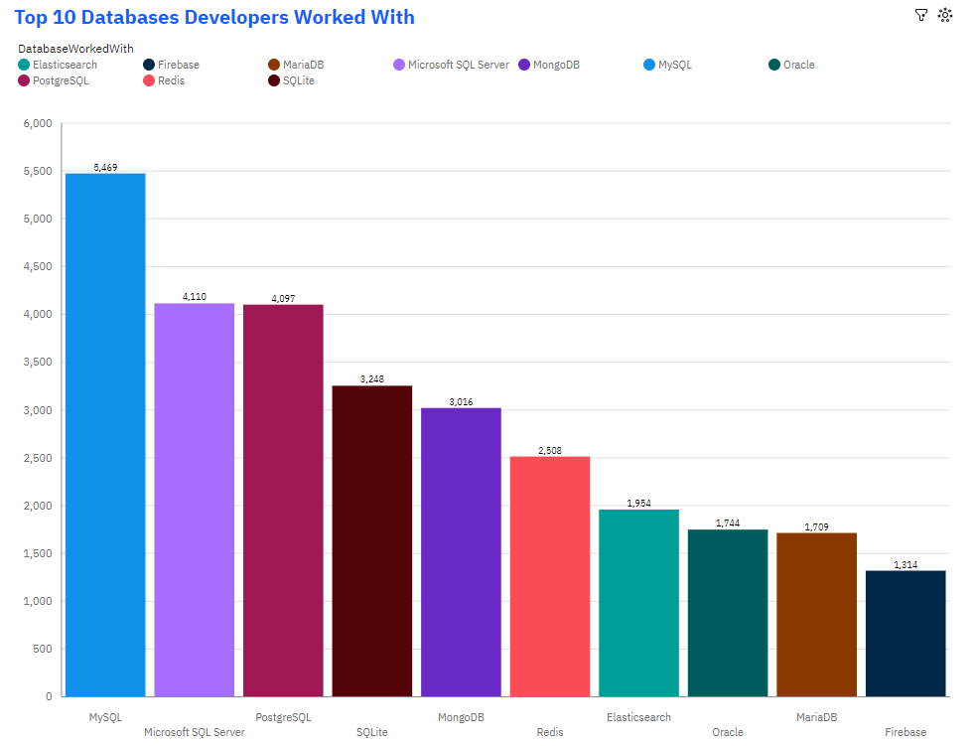
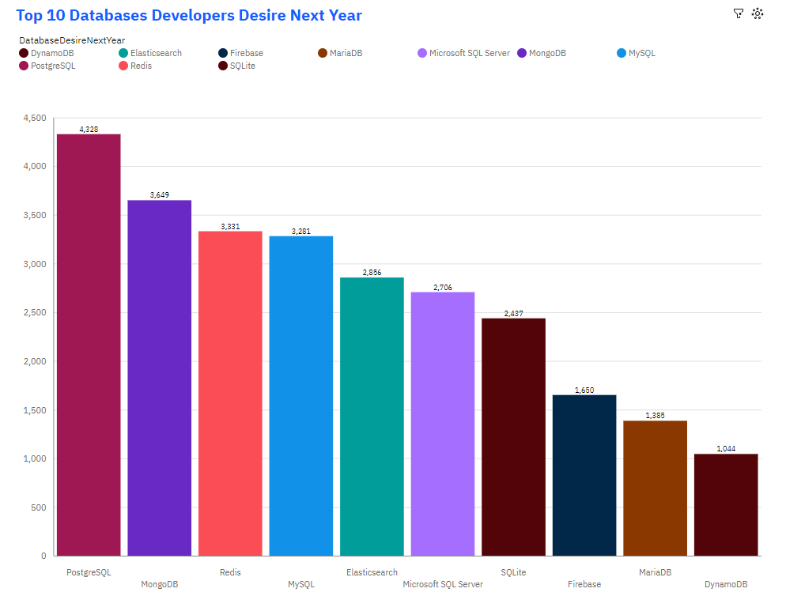
DATABASE TRENDS

Slide 10
DATABASE TRENDS - FINDINGS & IMPLICATIONS
Findings
PostgreSQL is consistently popular and ranks high in both the "work with" and "desire" chart
MongoDB and Redis experience significant increases in desirability, indicating a growing demand for NoSQL databases and in-memory data storage solutions
Microsoft SQL Server maintains a strong presence in both lists, showcasing its continued relevance
Implications
Focus on enhancing skills in PostgreSQL to capitalize on its popularity and high demand
Consider expanding expertise in MongoDB and Redis to meet the growing demand for NoSQL databases and in-memory data storage solutions
Stay updated with advancements in Microsoft SQL Server to maintain proficiency in this widely used database management system

Slide 11

DASHBOARD
https://us3.ca.analytics.ibm.com/bi/?perspective=dashboard&pathRef=.my_folders%2Ffinal%2Bcapstone%2Bproject&action=view&mode=dashboard&subView=model0000018a07a5d09d_00000000

Slide 12
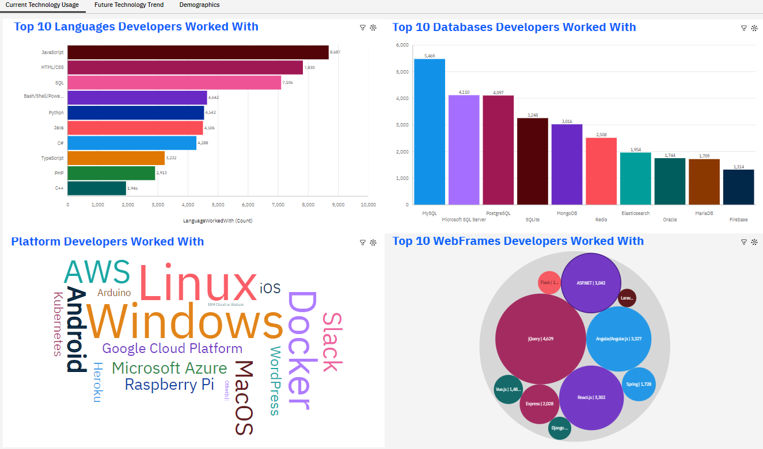
DASHBOARD TAB 1

Slide 13
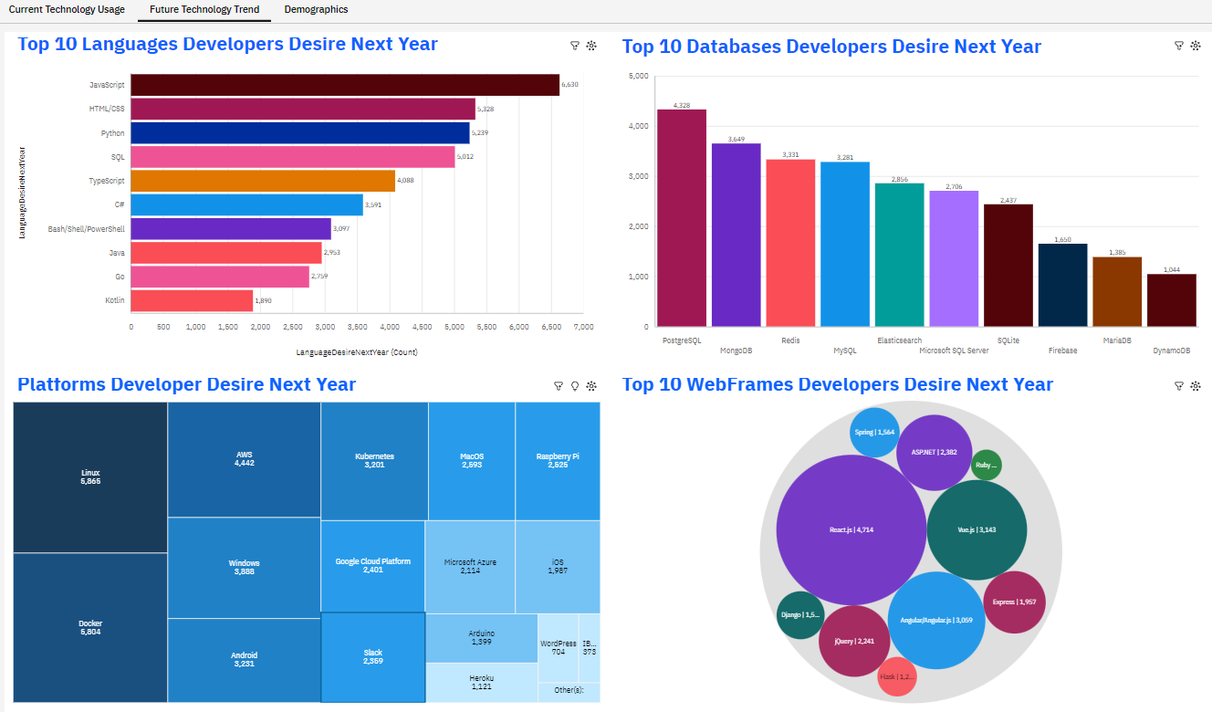
DASHBOARD TAB 2

Slide 14
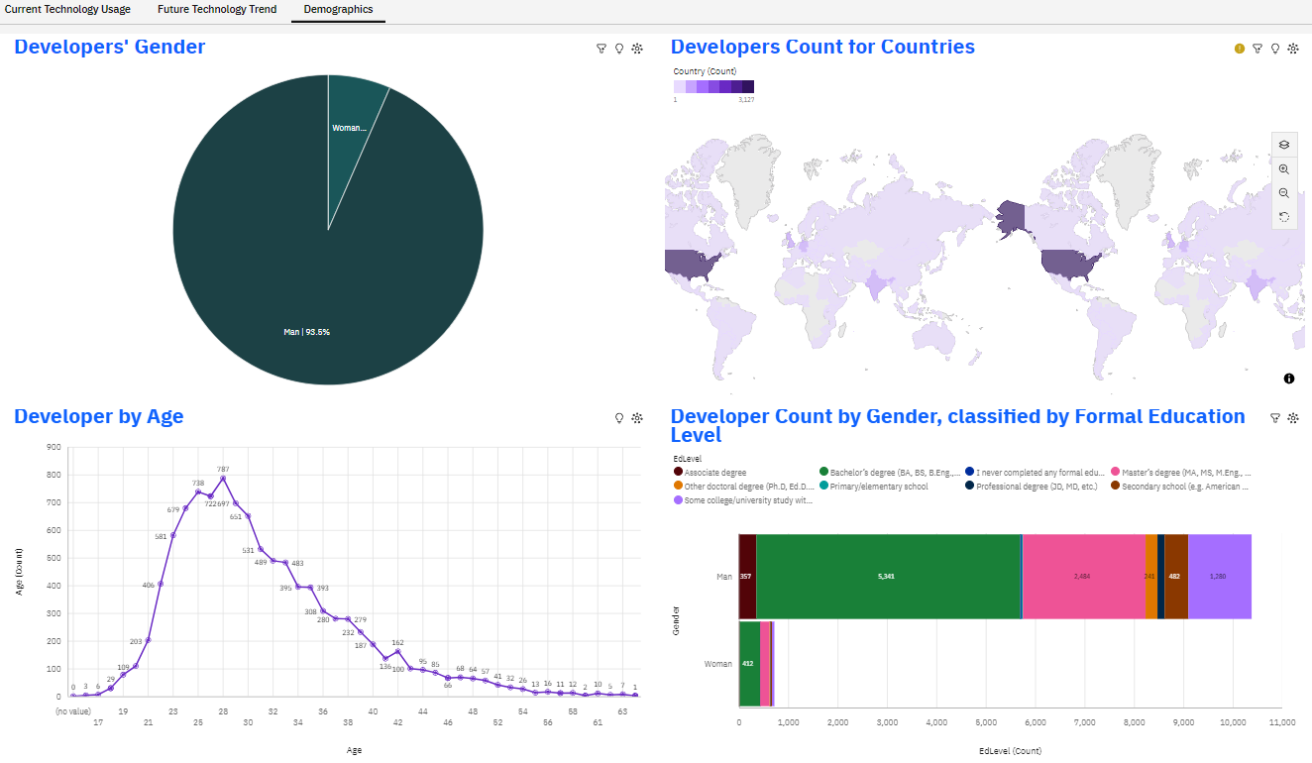
DASHBOARD TAB 3

Slide 15
DISCUSSION
What is the trend of different type of technology tools?
Geographical distribution of IT developers
The Age, Gender and education of IT developers

Slide 16
OVERALL FINDINGS & IMPLICATIONS
Findings
There is always a raidly change in IT industry every year
Most of the IT developers are focus in USA
There are extreme gender discrimination
Implications
Organisation and Developer should always update the latest and skill set to fufill the market demand
Compare with USA, IT industry is still developing and there is a high opportunies in other countries
Organizations should consider female developers on an equal footing with male developers

Slide 17

CONCLUSION
Current Technology Usage
Languages
Databases
Platform
WebFrames
Future Technology Usage
Languages
Databases
Platform
WebFrames
Demographic
Gender
Age
Geographical
Education level

Slide 18
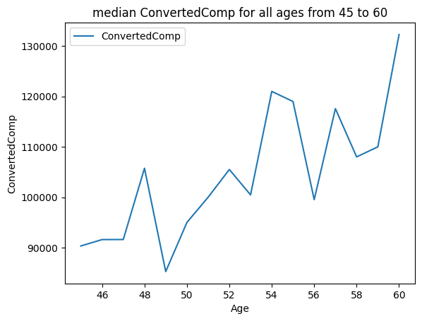

APPENDIX

Slide 19
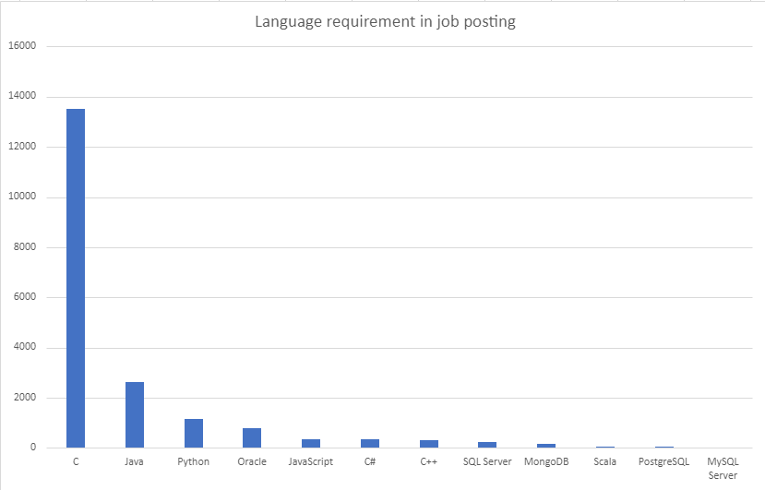
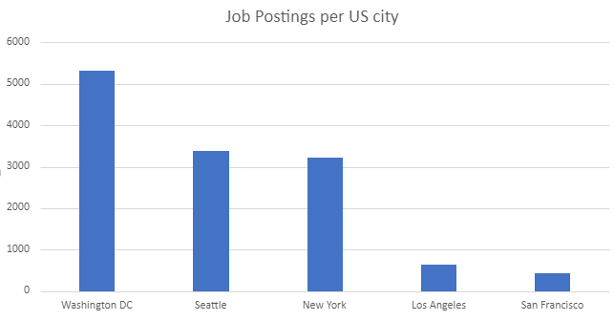
JOB POSTINGS

Slide 20
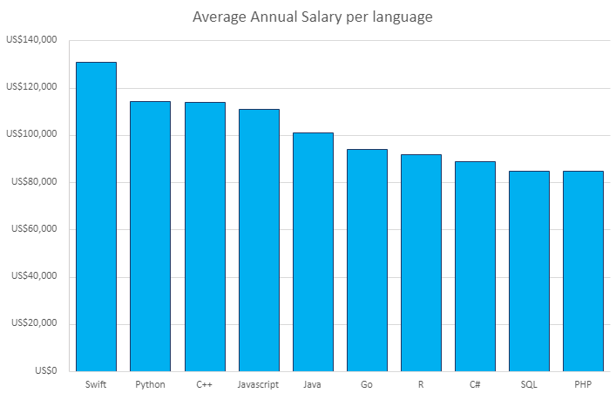
POPULAR LANGUAGES

